Slide 1
Design of Attendance Monitoring System Using RFID
K. Aravindhan
Dr.S.K.B.Sangeetha
Dr. K.Periyakaruppan
K.P.Keerthana
V.Sanjay Giridhar
V.Shamaladevi

Slide 2
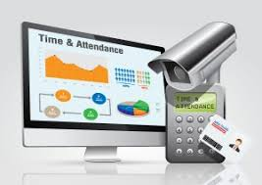

INTRODUTION
Controlling costs in any business is one of the most critical elements of sound financial management.
Staffing costs are usually one of the biggest categories of spend for most businesses. This is why it is important to make staff planning and wage calculations as efficient and accurate as possible.
Wage labor involves the exchange of money for time spent at work

Slide 3
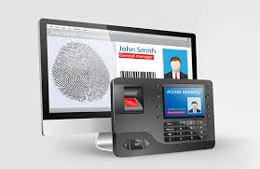


EXISTING SYSTEM
The existing system is biometrics which is over cost to implement in small organization.
The existing system also need a specific server to store the database.

Slide 4
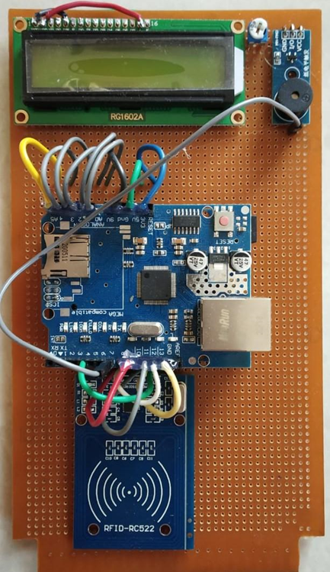
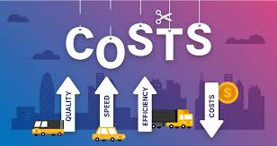
PROPOSED SYSTEM
The RFID based attendance system has also enabled the organization administration to ensure only accredited people access the organization premises. This goes a long way in enhancing the general security within the organization.

Slide 5
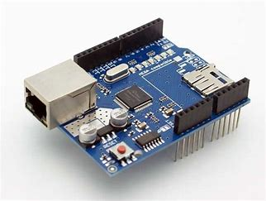
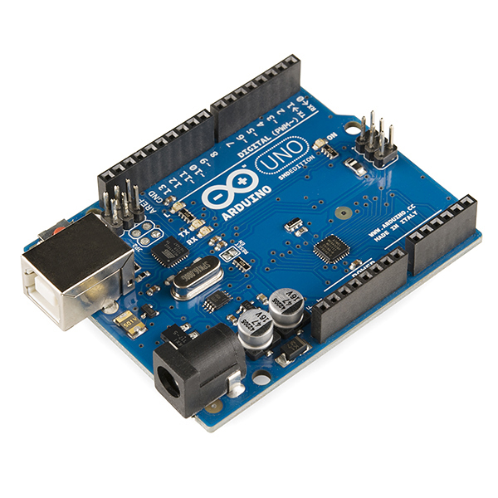
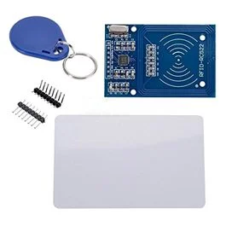
COMPONENTS

Slide 6
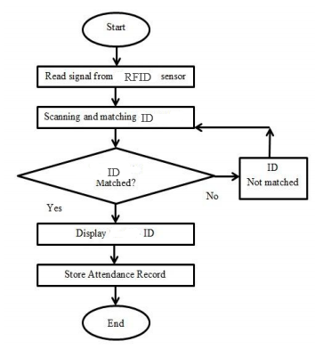
FLOW DIAGRAM

Slide 7
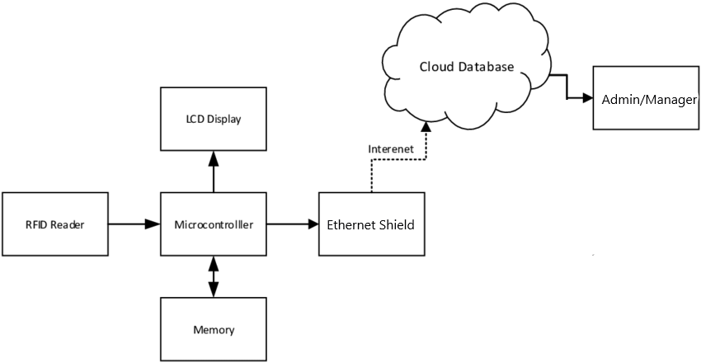
ARCHITECTURE

Slide 8
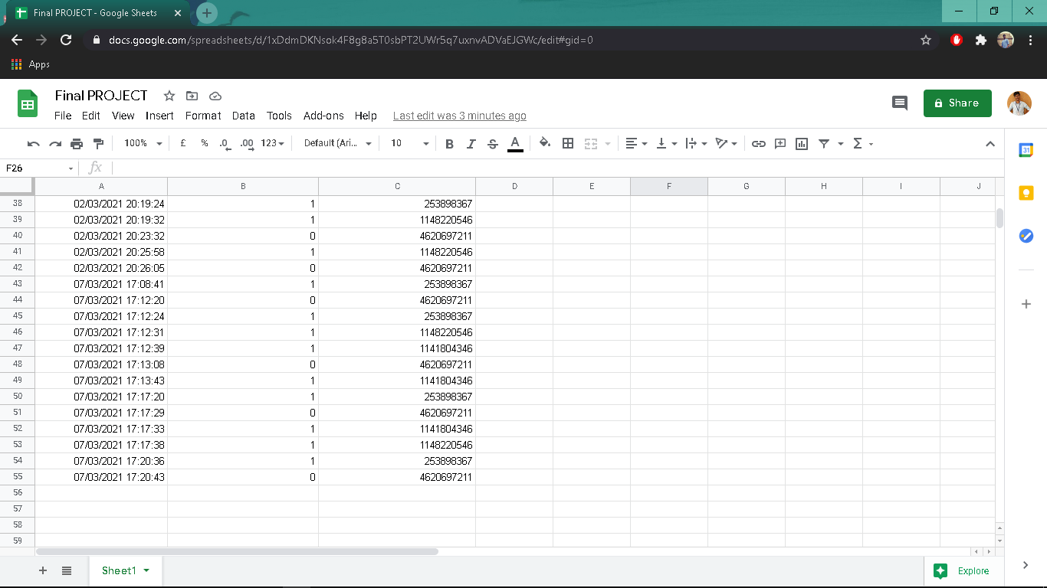
RESULT

Slide 9

QUESTION TIME

Slide 10
THANK YOU

